Slide 1


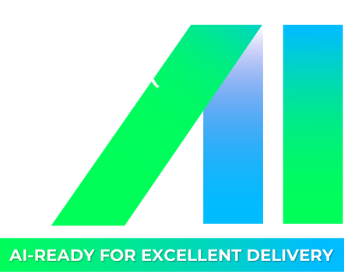
🚀 Hackathon: Building an Intelligent Domain-Specific AI Assistant with RAG Technology
Topic: Travel AI Assistant
Team: AI Beginner
16 Aug 2025

Slide 2

🎯 Hackathon
Agenda:
Introduction
API - Function
Demo
System Architectural Design
LangGraph flowchart
Q&A

Slide 3
🎯 Hackathon
1. Introduction
1.1 Purpose
Build an interactive web AI chatbot support text & image queries about travel and food to provide detailed info, restaurant suggestions, and Google Maps links.
1.2 Product Features
Smart interaction: Answer travel & food queries
Multimodal analysis: Understand text and images
Rich information: Descriptions, suggestions, maps, weather
Accessibility: Text-to-Speech support
Knowledge management: Easy updates via Admin

Slide 4
🎯 Hackathon
2. API - Function
Azure OpenAI API: for use OpenAI model.
ChromaDB: Vector DataBase for saving data.
Hugging Face API (TTS): transfer the answer from text to Speech.
LangGraph: Use to orchestrate a stateful workflow that connects various components in the RAG pipeline.
RAG: Allow chatbot to retrieve relevant text from ChromaDB to provide context for the LLM.

Slide 5
🎯 Hackathon
Demo

Slide 6
🎯 Hackathon
User's Browser
3. System Architectural Design
Frontend (HTML, CSS, JS)
HTTP/HTTPS Requests
FLASK APPLICATION SERVER
Frontend Serving
(templates & static files)
Backend API Routes (api/chat, /api/tts, ..)
LangGraph AI Agent
Azure OpenAI
(LLM, Vision)
ChromaDB
(Vector Store)
Hugging Face TTS (API )

Slide 7
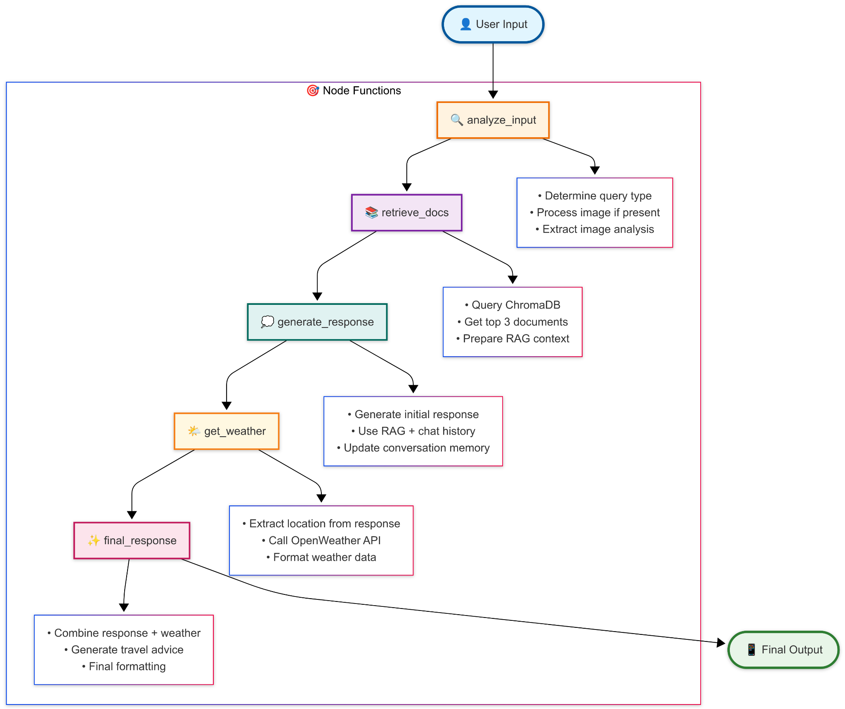
🎯 Hackathon
4. LangGraph flowchart

Slide 8
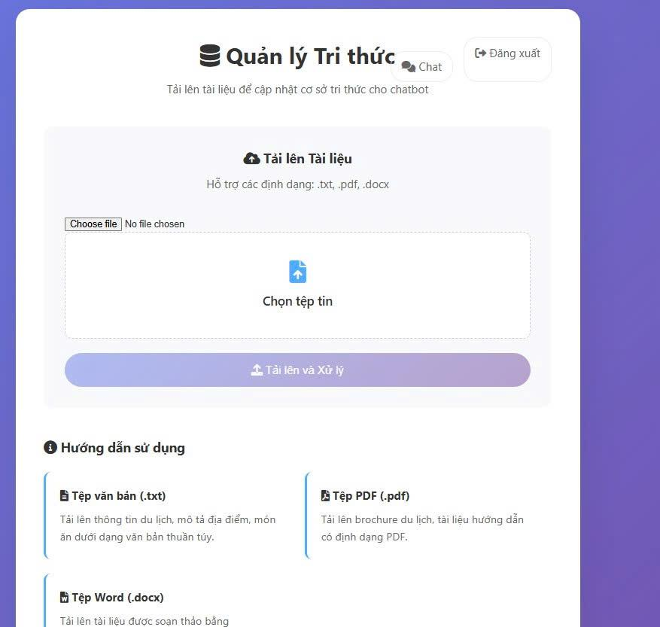
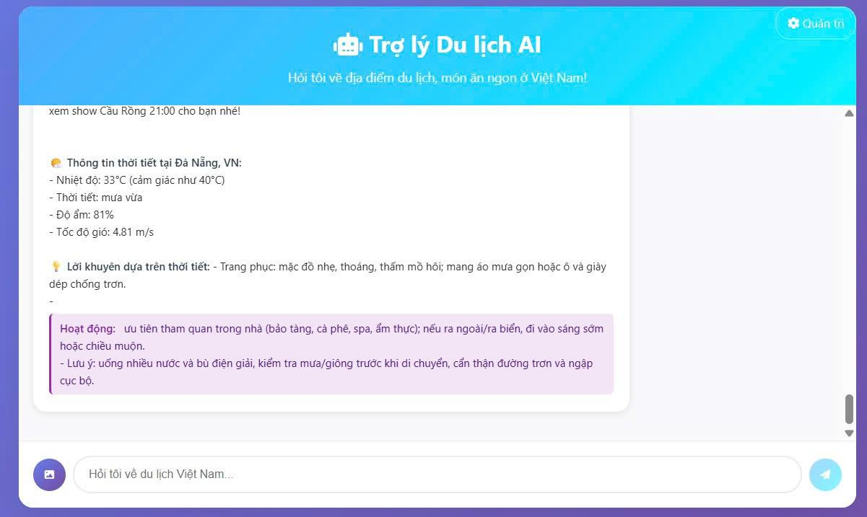
🎯 Hackathon
5. Q&A
Admin Browser: Include Document for Chatbot (txt, doc, pdf)
User Browser: Enter your Question.

Slide 9

THANK YOU!
8

